Slide 1
IBM Data Science Capstone Project The Battle of Neighbourhoods
Final Report
Introduction/Business Problem
Paris, capital of France, is one of the most important and influential cities in the world. In terms of tourism, Paris is the second most visited city in Europe after London. The capital of France seems to have been designed specifically for the enjoyment of its visitors. Its streets, squares, buildings, gardens, and monuments beckon tourists to return, and indeed, many do.
Tourists from everywhere of the world visit Paris every day in two ways basically: with travel agencies providing standard "must see" guided tours or plan themselves with the help of websites or travel app full of impersonalised recommendation. Time is short and time is money. How to make the trip as personalised as possible so make the days in Paris as profitable as possible? Customised travel services are usually very expensive and not accessible to everyone then they always rely on experimented human guide expertise which can be asynchronized in terms of POI (Points of Interests) data.
This project will try to give access to everyone the possibility to customise his trip in Paris based on his personal interests. With the help of data visualisation, he can easily make his ideas on which Parisian arrondissement to be visited on priority with a deeper understanding on points of interests in different categories of arrondissement.

Slide 2
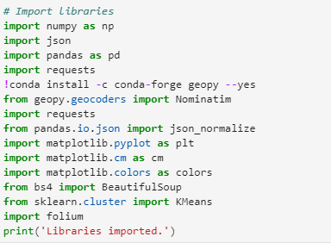
Data section
To accomplish this project two important data sets are necessary.
Geo-Coordinate Data:
For this project we will use dataset from opendata.paris.fr for the arrondissements of Paris.
Points of Interests Data:
We will need data about different venues across all of Paris and connect each venue to its respective arrondissement. To gain this information, we will use Foursquare API.
Methodology
1. Import necessary libraries to Jupiter Notebook

Slide 3
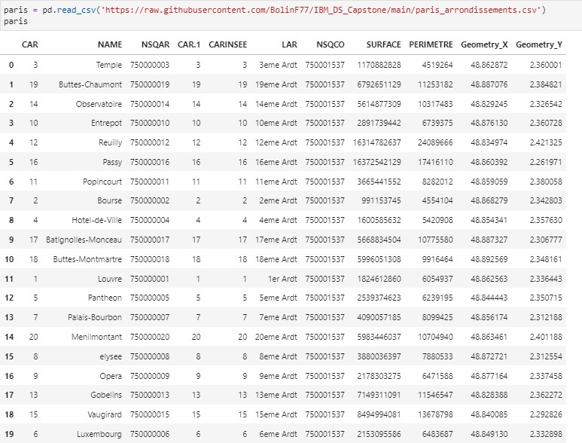
2. Data Collection - Download and load geo-coordinate data to Pandas Dataframe format.
3. Data wrangling – Rename the necessary columns and remove unnecessary columns

Slide 4
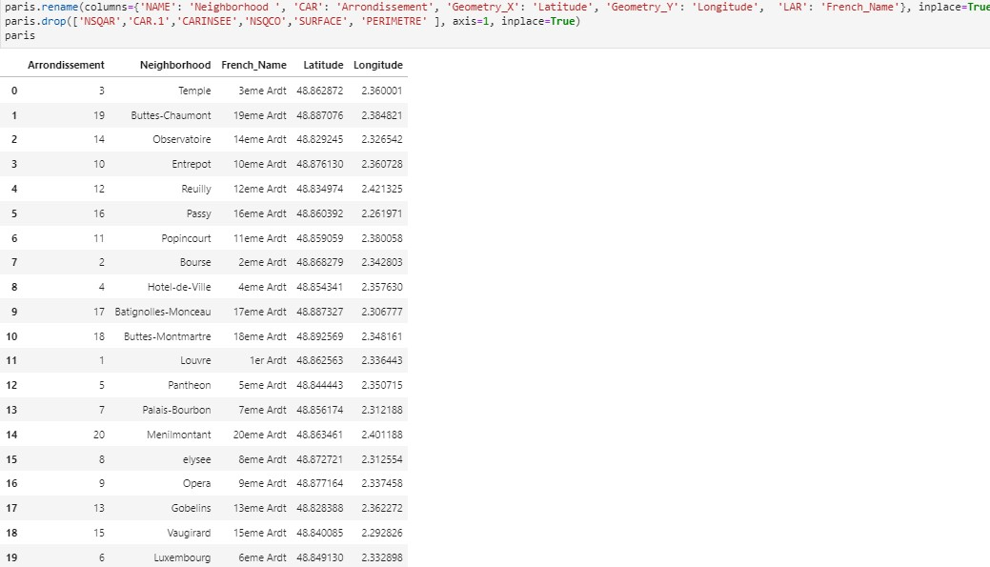
3. Data wrangling – Rename the necessary columns and remove unnecessary columns

Slide 5
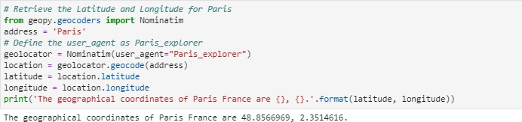
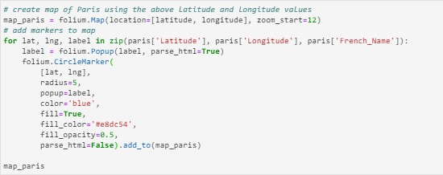
4. Get the latitude and longitude values of Paris with the help of geopy library
5. Create map of Paris using the arrondissements latitude and longitude values

Slide 6
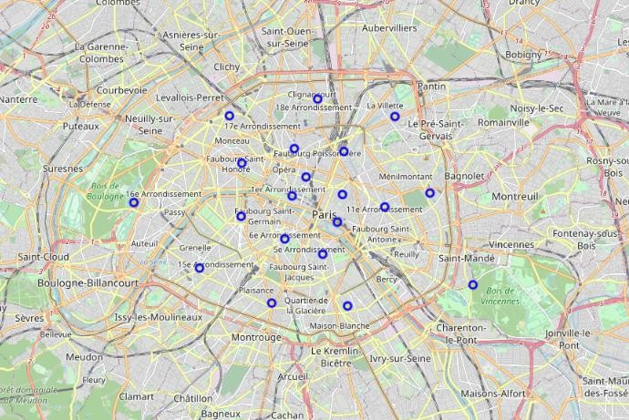
Until now, the preparation of the geo-coordinate data is finished. This first step is important as a foundation for further exploratory data analysis. For this project the ETL (Extract Transform Load) process is quite simple, and light weighted so no SQL commands are needed. For projects with voluminous data, we might have to request databases with SQL.
6. This step starts the query to Points of Interests (POI) data by using Foursquare API, after API authentication and request engineering cf. Jupiter Notebook for details, we explored all points of interests in all arrondissements in Paris

Slide 7
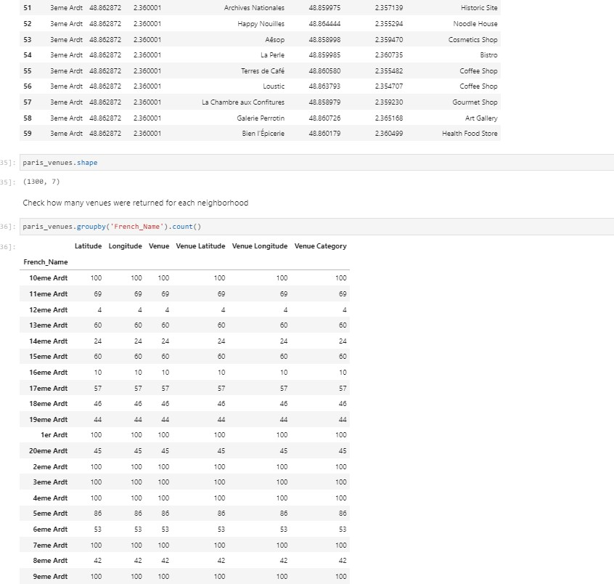

Slide 8
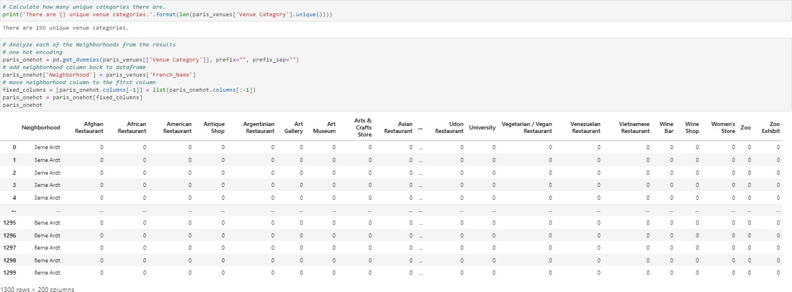
According to the dataframe shape, we count 1300 venues POI in Paris and we list the number of venues by arrondissement.
7. Calculate the number of unique categories and encode venues in arrondissement by using one hot encoding method
This top 10 venues’ categories list is already very useful to provide deeper insights to tourists so they can already more structured ideas on where they may want to visit relating to their interests. To make easier and more visual, we want to use the K-means cluster method to let the data show us if there are clusters so tourists can combine different arrondissement when they make their visit path or when they want to choose and ideal hotel to stay in a more flexible and efficient way.
9. K-means clustering (unsupervised machine learning, K = 9)

Slide 9
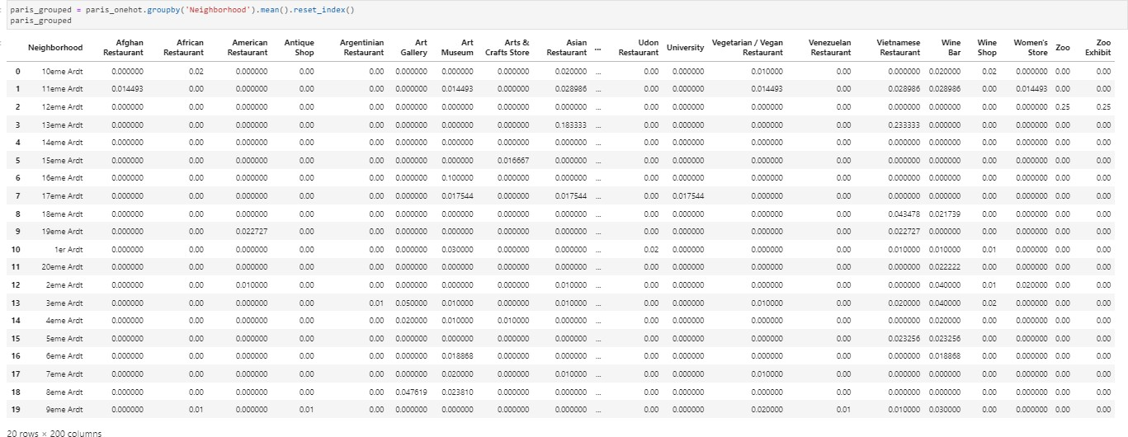
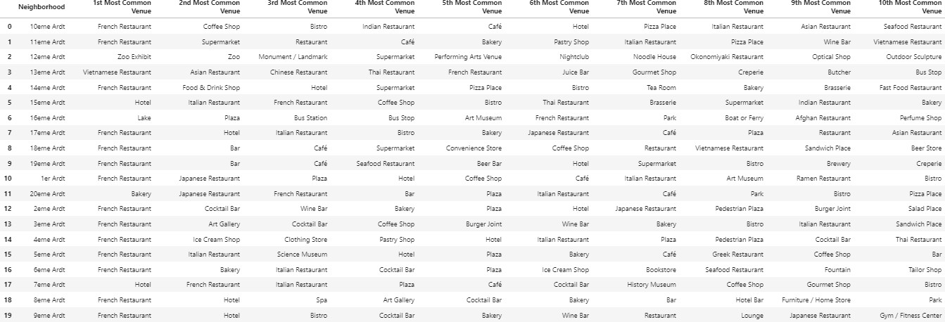
8. Find the top 10 venues’ categories by arrondissement

Slide 10
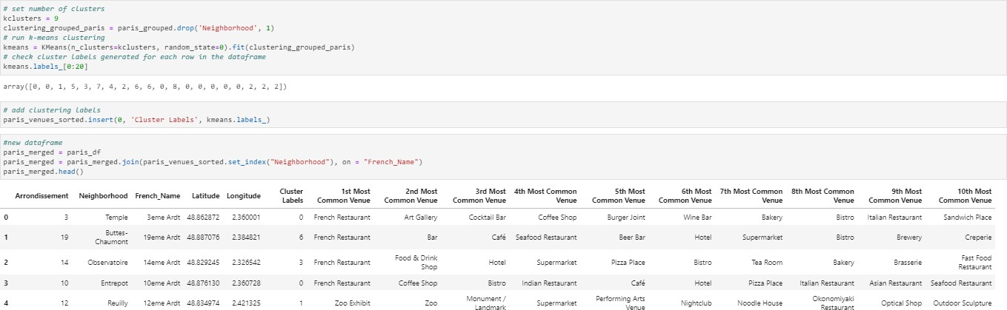
This top 10 venues’ categories list is already very useful to provide deeper insights to tourists so they can already more structured ideas on where they may want to visit relating to their interests. To make easier and more visual, we want to use the K-means cluster method to let the data show us if there are clusters so tourists can combine different arrondissement when they make their visit path or when they want to choose and ideal hotel to stay in a more flexible and efficient way.
9. K-means clustering (unsupervised machine learning, K = 9)
- Cluster 2 – Hotel, Restaurant, Bar

Slide 11
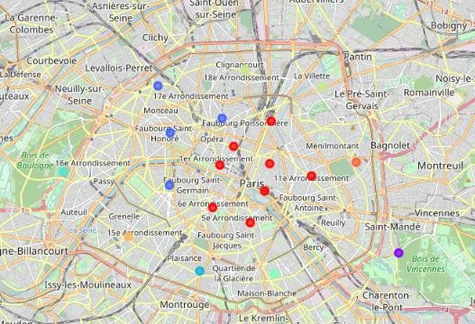

Slide 12
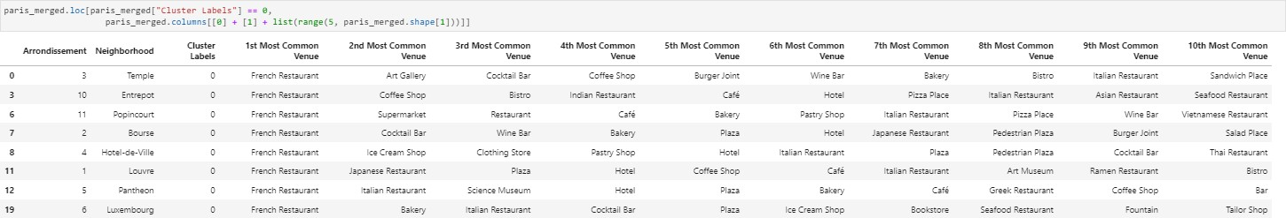
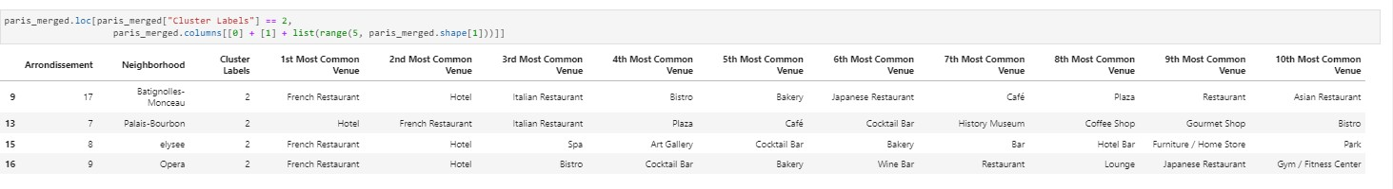
10. Cluster’s analysis
- Cluster 0 – Restaurant, Bar, Coffee and Ice-cream
Cluster 2 – Hotel, Restaurant, Bar

Slide 13
Discussion
According to the results of K-means clustering, we can see two obvious clusters which share the same categories of POI: Cluster 0 is a zone where tourists will have no difficulties to find restaurants especially good French restaurants as well as bars and ice-cream shops. Cluster 2 is an area where tourists will easily find hotels and European restaurants. As we setup the K=9 for 20 arrondissement, we can a fine granularity for clustering so besides there two obvious clusters each containing more than 3 arrondissements, we have also other “stand-alone” arrondissements with their unique top 10 POI categories. These “stand-alone” cluster can be also useful as a summary of the specialities and can help tourists to combine different clusters to plan their own customised trip. Tourists may also use the map of clusters to target a area to stay in the centre of many clusters they are interested in to facilitate their transport.
Conclusion
This project englobes and demonstrates basic data scientists’ skills in terms of data collection, data wrangling, data transformation (ETL) and Exploratory Data Analysis with unsupervised Machine Learning method: K-means. In addition, the data visualisation helps the illustration and explanation of findings. Tourists can use these data visualisations to better plan their trips with deeper understanding of points of interests in different clusters without the help of traditional travel agencies.

